Slide 1

UTA EE Lab Workshops
Raspberry Pi Touchscreen displays

Slide 2
The Datasheet and Pi software configuration
http://www.lcdwiki.com/MHS-3.5inch_RPi_Display
Physical resolution 320 x 480, with resistive touch control
It supports up to 125MHz SPI signal input, showing stable no screen and no flicker
Same size as the Raspberry Pi, perfectly compatible and can be directly inserted into any version of the Raspberry Pi (Raspberry Pi ZeroW, A, A+, B, B+, 2B, 3B, 3B+,4B)
Support Raspbian/Ubuntu/Kali system, provide driver and image
Name | Description
SKU | MHS3528
Screen Size | 3.5inch
LCD Type | TFT
Module Interface | SPI (upports up to 125MHz SPI input)
Resolution | 320*480 (Pixel)
Touch Screen Controller | XPT2046
LCD Driver IC | ILI9486
Backlight | LED
power consumption | 0.16A*5V
Working temperature（℃） | -20~60
Active Area | 48.96x73.44(mm)
Module PCB Size | 85.42*55.60 (mm)
Package Size | 136x98x41 (mm)
Product Weight(Package containing)(g) | 92 (g)

Slide 3
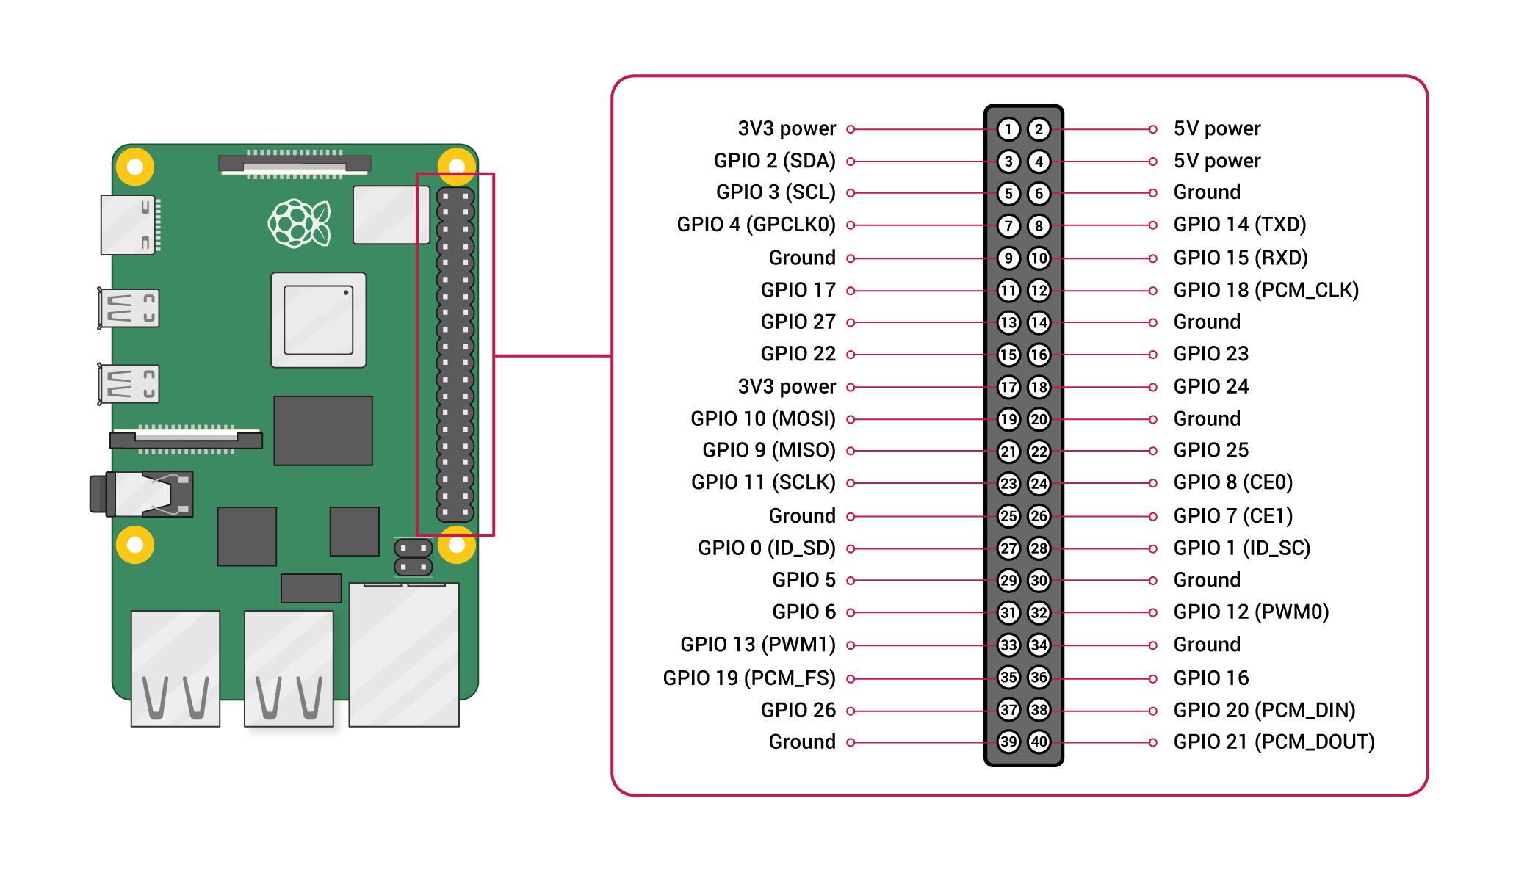
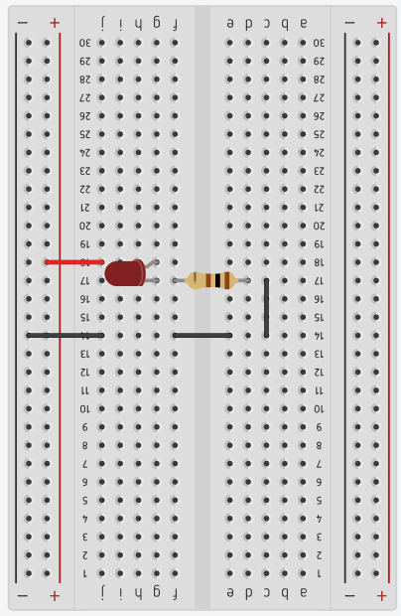
Add LED
100Ω

Slide 4
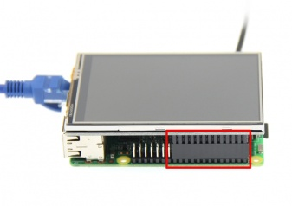
Install the Display
PIN NO. | SYMBOL | DESCRIPTION
1, 17 | 3.3V | Power positive (3.3V power input)
2, 4 | 5V | Power positive (5V power input)
3, 5, 7, 8, 10, 12, 13, 15, 16 | NC | NC
6, 9, 14, 20, 25 | GND | Power ground
11 | TP_IRQ | The touch panel is interrupted, and it is detected that the touch panel is pressed low
18 | LCD_RS | Instruction/data register selection, low level is instruction, high level is data
19 | LCD_SI / TP_SI | LCD display / touch panel SPI data input
21 | TP_SO | Touch panel SPI data output
22 | RST | Reset signal, low reset
23 | LCD_SCK / TP_SCK | LCD display / touch panel SPI clock signal
24 | LCD_CS | LCD chip select signal, low level enable
26 | TP_CS | Touch panel chip select signal, low level enable
Align right-side to insert the LCD screen
Plug-in MicroSD card, connect network and power
Plug in a mouse and display to get the IP so you can use VNC to control thru your computer

Slide 5

Power on the Pi
Use a Monitor, keyboard, mouse and Ethernet cable to power on the Pi.
Check if VNC is running in the upper right corner.
If it is, click it to get the IP address of the raspberry Pi.
If not, Click the “Raspberry” ->Preferences-> Raspberry Pi Configuration.
Select the Interfaces tab and enable VNC. Unplug the Monitor, keyboard and mouse and let the next person get their IP.

Slide 6
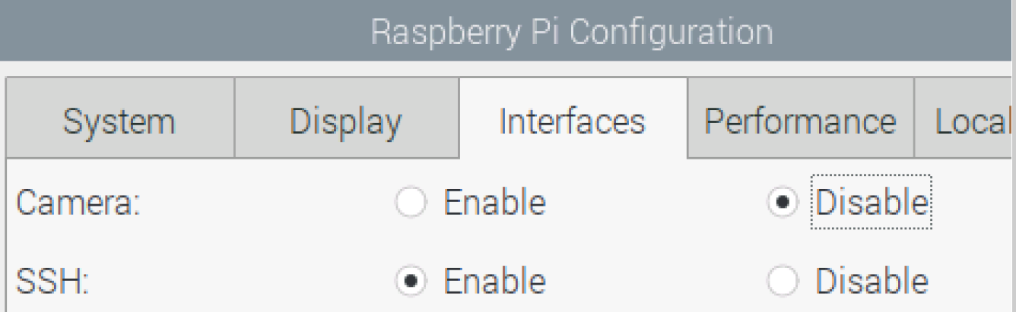
Enable SSH
Click the “Raspberry” ->Preferences-> Raspberry Pi Configuration.
Select the Interfaces tab and enable SSH.
Reboot the Pi

Slide 7
Install drivers
Enter the code one line at a time. You can copy and paste if you like.
sudo apt-get update
sudo rm -rf LCD-show
git clone https://github.com/goodtft/LCD-show.git
chmod -R 755 LCD-show
cd LCD-show/
sudo ./LCD35-show

Slide 8
Why do we want such a tiny screen?
We’ll make big buttons.
Using Python we will create a user interface with big buttons.

Slide 9

Let’s download Python onto our laptops
https://www.python.org/downloads/

Slide 10

We can develop the Python code on our laptops and transfer it to the Raspberry Pi later.
We will use this free Python IDE to create our python programs.
https://www.jetbrains.com/pycharm/download

Slide 11
Let’s code Python with TKinter
What we will do is very basic. I highly recommend the YouTube series on Tkinter by the new Boston. https://www.youtube.com/watch?v=RJB1Ek2Ko_Y&list=PL6gx4Cwl9DGBwibXFtPtflztSNPGuIB_d
Open a new project in Pycharm and type the following code.
Right click the code area and select run.
from tkinter import * root = Tk() theLabel= Label(root, text="Are we having fun yet?") theLabel.pack() root.mainloop()

Slide 12
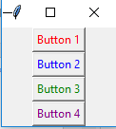
Lets put some buttons on that
from tkinter import * root = Tk() topFrame = Frame(root) topFrame.pack() bottomFrame = Frame(root) bottomFrame.pack(side=BOTTOM) button1 = Button(topFrame, text="Button 1", fg="red") button2 = Button(topFrame, text="Button 2", fg="blue") button3 = Button(topFrame, text="Button 3", fg="green") button4 = Button(bottomFrame, text="Button 4", fg="purple") button1.pack() button2.pack() button3.pack() button4.pack() root.mainloop()
Right click and select run when entered

Slide 13

Lets arrange these buttons
from tkinter import * root = Tk() topFrame = Frame(root) topFrame.pack() bottomFrame = Frame(root) bottomFrame.pack(side=BOTTOM) button1 = Button(topFrame, text="Button 1", fg="red") button2 = Button(topFrame, text="Button 2", fg="blue") button3 = Button(topFrame, text="Button 3", fg="green") button4 = Button(bottomFrame, text="Button 4", fg="purple") button1.pack(side=LEFT) button2.pack(side=LEFT) button3.pack(side=LEFT) button4.pack(side=BOTTOM) root.mainloop()

Slide 14
Using grid
from tkinter import * root = Tk() root.title("My Application") label_1 = Label(root, text="Name") label_2 = Label(root, text="Password") entry_1 = Entry(root) entry_2 = Entry(root) label_1.grid(row=0, sticky=W) label_2.grid(row=1) entry_1.grid(row=0, column = 1) entry_2.grid(row=1, column = 1) c = Checkbutton(root, text="Keep me logged in") c.grid(columnspan=2) root.mainloop()
Enter this and run it to see how grid organizes the UI

Slide 15
Button Function
Binding a function to a widget
from tkinter import * root = Tk() def printName(): print("Type your name here") button_1 = Button(root, text="Print name to console", command=printName()) button_1.pack() root.mainloop()

Slide 16
Button Function
Modify the code like this
from tkinter import * root = Tk() def printName(event): print("Type your name here") button_1 = Button(root, text="Print name to console") button_1.bind("<Button-1>", printName) button_1.pack() root.mainloop()

Slide 17
Time for Pi
from tkinter import * import RPi.GPIO as GPIO import time GPIO.setmode(GPIO.BCM) GPIO.setwarnings(False) GPIO.setup(21,GPIO.OUT) GPIO.output(21,GPIO.LOW) root = Tk() def ledOn(event): GPIO.output(21, GPIO.HIGH) def ledOff(event): GPIO.output(21, GPIO.LOW) button_1 = Button(root, text="Turn on LED")
button_1.config(height=5, width=20) button_1.bind("<Button-1>", ledOn) button_2 = Button(root, text="Turn off LED")
button_2.config(height=5, width=20) button_2.bind("<Button-1>", ledOff) button_1.pack() button_2.pack() root.mainloop()
We will need to run this on the raspberry Pi
Type this in Thonny.

Slide 18
How to auto Start a program in Raspberry PI OS / Linux
Navigate to /etc/xdg/autostart and open the terminal window
Type sudo nano autostart.desktop
[Desktop Entry]
Version=1.0
Type=Application
Terminal=false
StartupNotify=true
Name=NAME OF YOUR STARTUP PROGRAM
Comment=short description of you startup program
Exec=lxterminal –command “/home/pi/Desktop/autostart.sh”
Categories=Application;

Slide 19
How to auto Start a program in Raspberry PI OS / Linux
Use Control + o to write out the file, then press enter to save it by the name.
Use Control + x to exit the program
Now we need to make the program executable.
Type sudo chmod u+x autostart.desktop

Slide 20
How to auto Start a program in Raspberry PI OS / Linux
Open the terminal in the Desktop directory.
Type sudo nano autostart.sh
Enter the following info
#!/bin/sh
#get rid of the cursor so we don’t see it when our program runs
setterm –cursor off
#Make Python 3 our default version
SERVICE=“python3”
#Now we put in a loop
While true; do
$SERVICE /home/pi/[path to your program]/BlinkLED.py
done

Slide 21
How to auto Start a program in Raspberry PI OS / Linux
Type Control + o and press enter to save it.
We need to make it executable also.
Type sudo chmod u+x autostart.sh
Reboot the Raspberry Pi and your Python program should auto start.

Slide 22
Let’s set the Pi back to the HDMI
Open the terminal window
cd LCD-show
sudo ./LCD-hdmi

